Slide 1

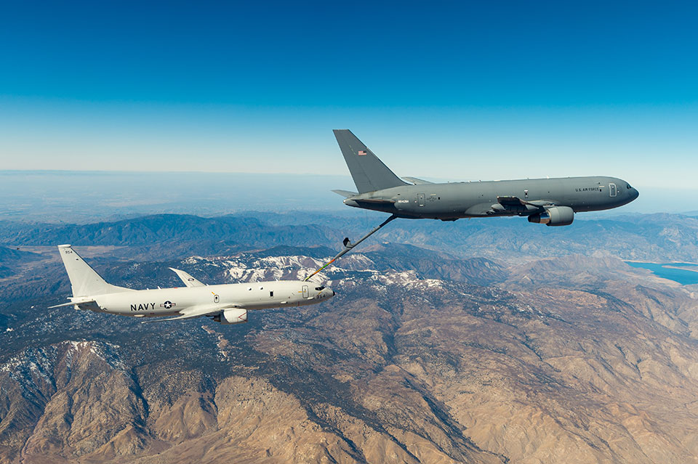
Mr. Thomas – Spring 2026
Refuel/Jet Lag and Office Hours Schedule
Refuel / Jet Lag Schedule
  Monday, Wednesday, Friday
    1145-1215
  Tuesday & Thursday – not available
Office Hours
  Tuesday, Thursday
    0715-0800
  Other times by appointment

